Slide 1
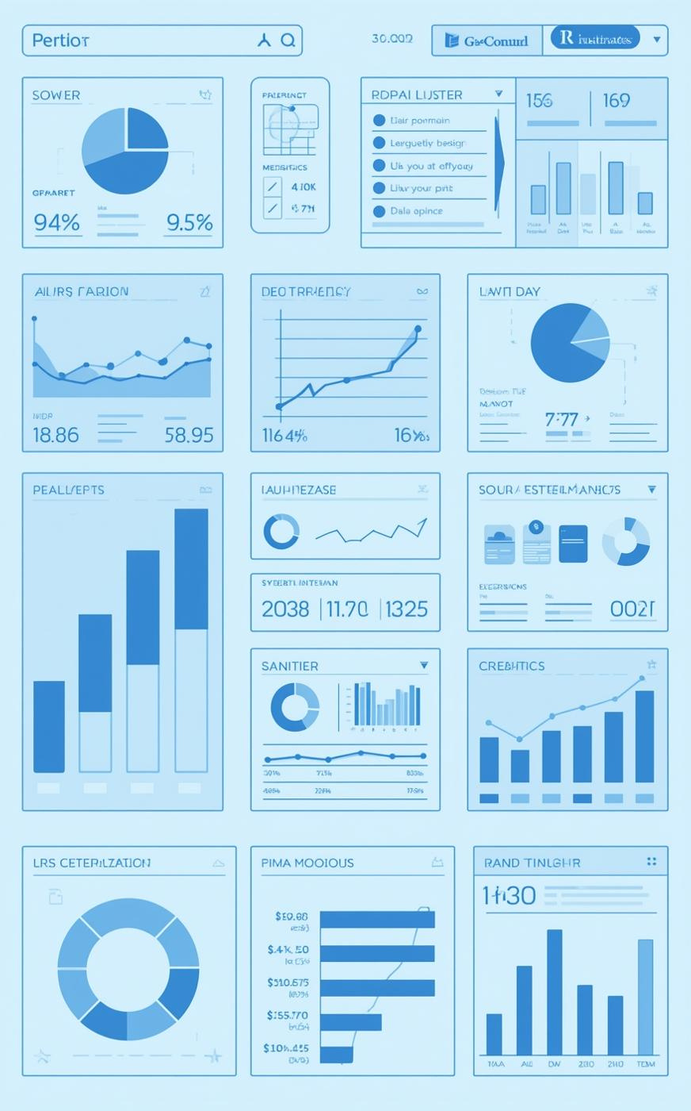

OLIST
E-Commerce Performance Analysis

Slide 2

Strategic Growth Objective
Data-Driven Insights
01
02
03
Customer Behavior
Payment Trends
Delivery Patterns
Analyze purchase trends and preferences
Examine popular payment methods used
Investigate efficiency and customer feedback

Slide 3
TOTAL ORDERS
99K
Orders processed monthly
Key Performance Indicators
8.40%
GROWTH PERCENTAGE
Overall Growth
Essential Metrics for Olist's Success
12.5
AVG SHIPPING TIME
Days to deliver

Slide 4
Sales Performance Analysis
$12.16M
$3.58M
Weekday Sales
Weekend Sales
Weekday sales represent a significant portion of total revenue, contributing 77% of overall sales compared to weekend sales, highlighting the importance of strategic weekday marketing efforts.
Weekend sales remain low at 23%, showing a clear weekday preference among customers. Opportunity drive weekend conversions with targeted offers.

Slide 5
Review Score Analysis
Understanding customer feedback trends
1★ Ratings
2★ Ratings
3★ Ratings
The 11,000 one-star ratings indicate significant dissatisfaction, often linked to delayed shipping times, averaging 21 days, which negatively impacts overall customer retention.
With 3,000 two-star reviews, customers express frustration with service, typically citing issues like long shipping duration of around 17 days and unmet expectations.
The 8,000 three-star ratings suggest a mixed experience, where customers acknowledge some service aspects but remain unsatisfied due to average shipping times of 14 days.

Slide 6
Review Score Insights
Correlation with Shipping Time
4★ Reviews
5★ Reviews
Shipping Impact
A total of 19,000 four-star reviews indicates customer satisfaction, highlighting areas where service meets expectations, contributing positively to overall business metrics.
With 57,000 five-star reviews, the overwhelming positive feedback demonstrates high levels of customer satisfaction, showcasing the effectiveness of service and product quality.
The average shipping time of 12 days for four-star reviews suggests that timely delivery is crucial for maintaining customer satisfaction and receiving higher ratings.

Slide 7




Logistics Optimization Solutions
Micro-fulfillment
Courier Ranking
Predictive Delays
Priority SKUs
Establish local hubs for efficient deliveries
Implement system to assess delivery performance
Use data to anticipate shipment issues
Focus on high-demand items for quick shipping

Slide 8

Payment Methods
Credit Card
The dominant payment method, credit cards accounted for 75K orders, highlighting their importance in facilitating quick and efficient transactions for customers.
Insights into preferred payment options for orders
Boleto
With 20K orders, Boleto remains a popular choice among customers, especially those who prefer secure, cash-based payment options that avoid potential credit card issues.
Voucher
Vouchers, while less common, still contributed with 3K orders, demonstrating a growing trend in alternative payment methods that appeal to a specific segment of our customer base.

Slide 9




Marketing & Sales Strategies
Weekday Campaigns
City-Focused Ads
Top-Category Marketing
Weekend Conversion Boosts
Targeted promotions boost weekday engagement
Tailored messaging for local audiences
Spotlighting popular products increases visibility
Encouraging shopping during peak times

Slide 10
Top Categories Analysis
Bed Bath Table
Health & Beauty
Revenue from the Bed Bath Table category reached $639K, reflecting the importance of home-related products in customer purchasing decisions.
The Health & Beauty category has generated impressive revenue, contributing $875K to overall sales, indicating strong customer interest.
Watches Gifts
Sports Leisure
The Watches Gifts segment has also performed well, bringing in $759K, showcasing a growing demand for quality timepieces among customers.
The Sports Leisure category achieved $616K in sales, demonstrating a robust market for athletic and recreational products among our client base.
Computers Accessories
Housewares
The Computers Accessories category generated $588K in sales, showcasing strong consumer interest in tech-related products and solutions.
With $484K in sales, Housewares reflect a growing trend in home improvement and essentials among our customer base.

Slide 11
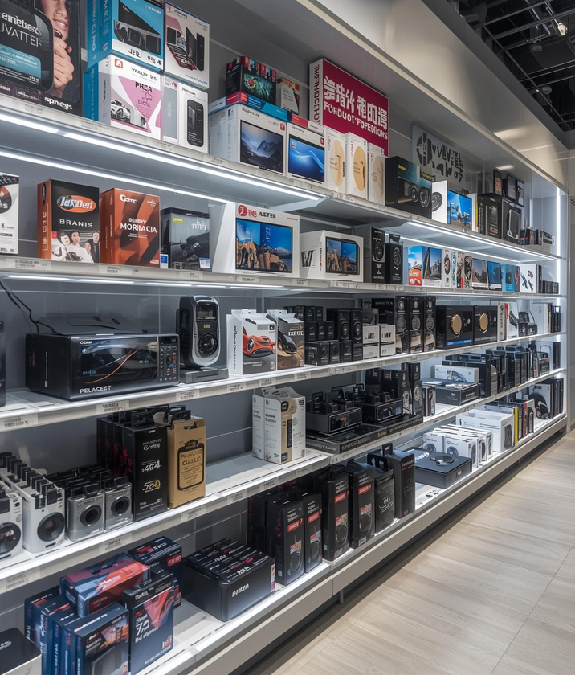
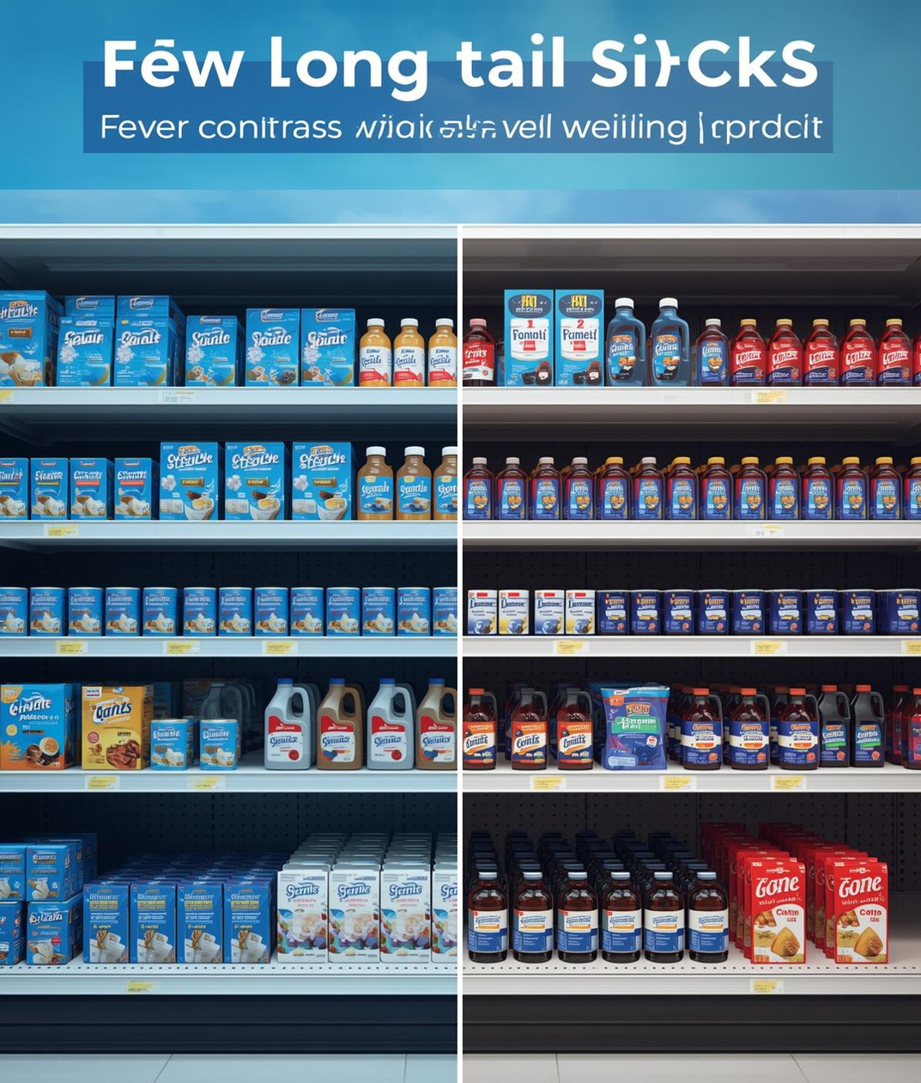


Enhancing Product Categories
Expansion
Reduction
Premiumization
Diversity
Broaden the range of top categories
Minimize the impact of long-tail SKUs
Introduce premium product lines
Increase product variety and appeal

Slide 12
Seller States Performance
São Paulo
Rio de Janeiro
SP accounts for 65.16% of total orders, averaging 12.30 days for shipping, demonstrating efficiency in service delivery.
RJ completed 4311 orders with an impressive average shipping time of 12.03 days, showing strong operational performance.
Minas Gerais
Paraná
MG processed 7844 orders with an average shipping time of 12.82 days, indicating slightly longer delivery than SP.
PR had 7589 orders with an average of 13.38 days for shipping, suggesting room for improvement in logistics efficiency.
Santa Catarina
Rio Grande do Sul
SC reported 3,615 orders with an average shipping time of 13.70 days, highlighting areas for logistics improvement.
RS achieved 1,976 orders while maintaining a commendable average of 11.47 days for shipping, reflecting efficient service.

Slide 13



Scorecards
Comprehensive metrics to track seller performance effectively.
Enhancing Seller Performance for Success
Training
Tailored programs to enhance seller capabilities and skills.
Incentives
Reward systems to motivate and engage top sellers.

Slide 14
Strategic Roadmap
Short-term Goals
Mid-term Goals
Long-term Goals
Implement logistics improvements to reduce delivery times and enhance customer satisfaction.
Launch targeted marketing campaigns to increase brand visibility and drive sales growth.
Expand product categories and establish partnerships for sustainable long-term growth.

Slide 15
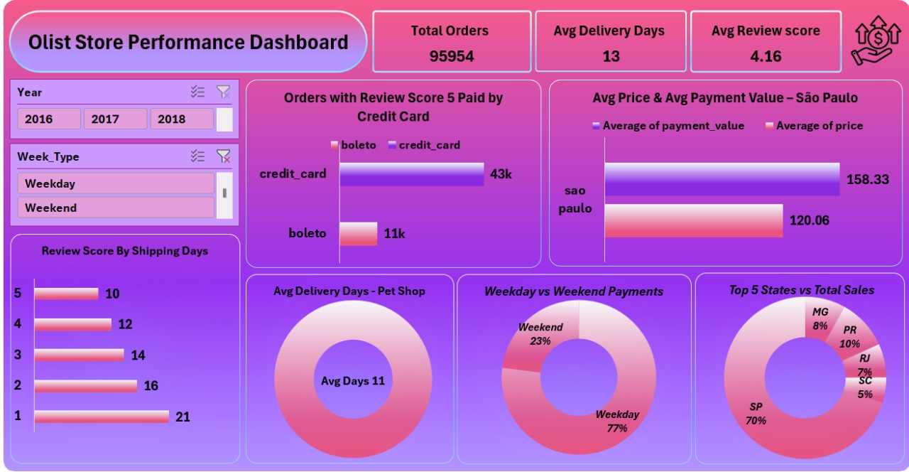
Excel Dashboard

Slide 16
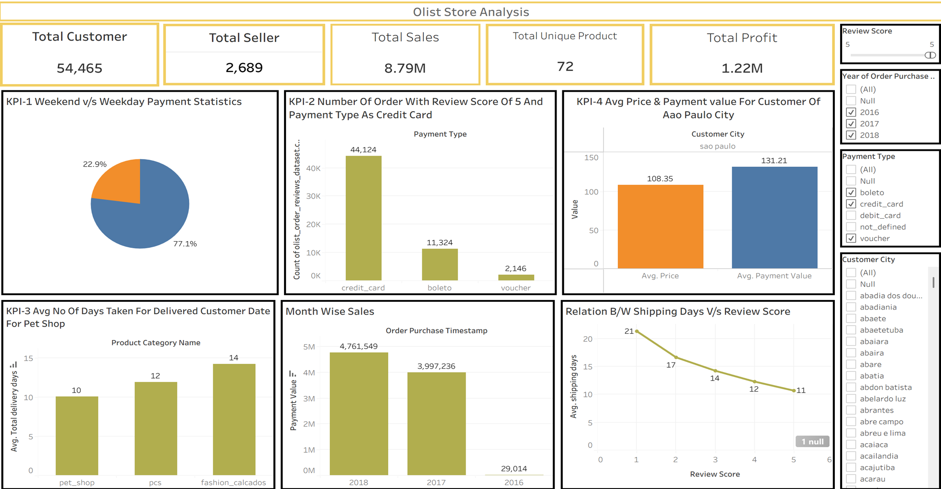
Tableau Dashboard

Slide 17
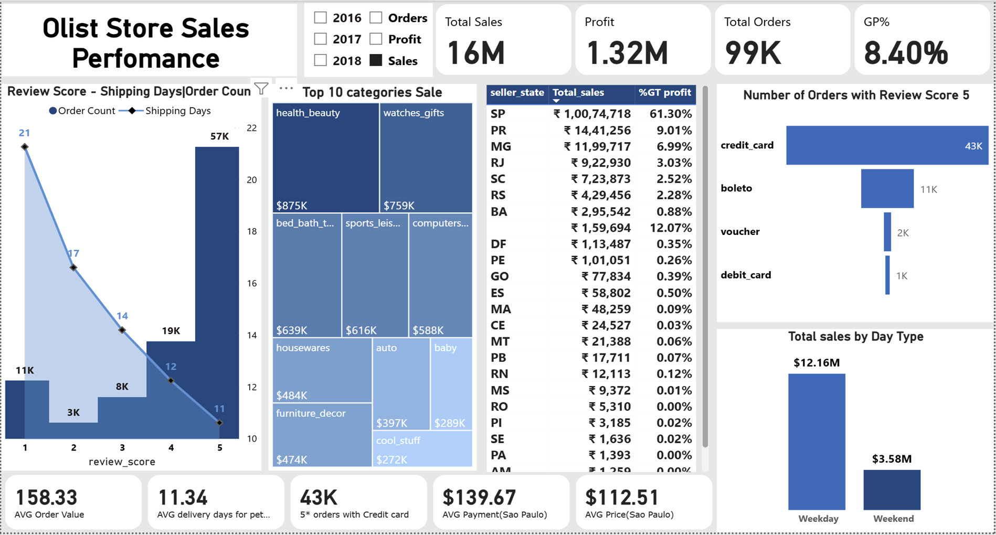
Power BI Dashboard

Slide 18
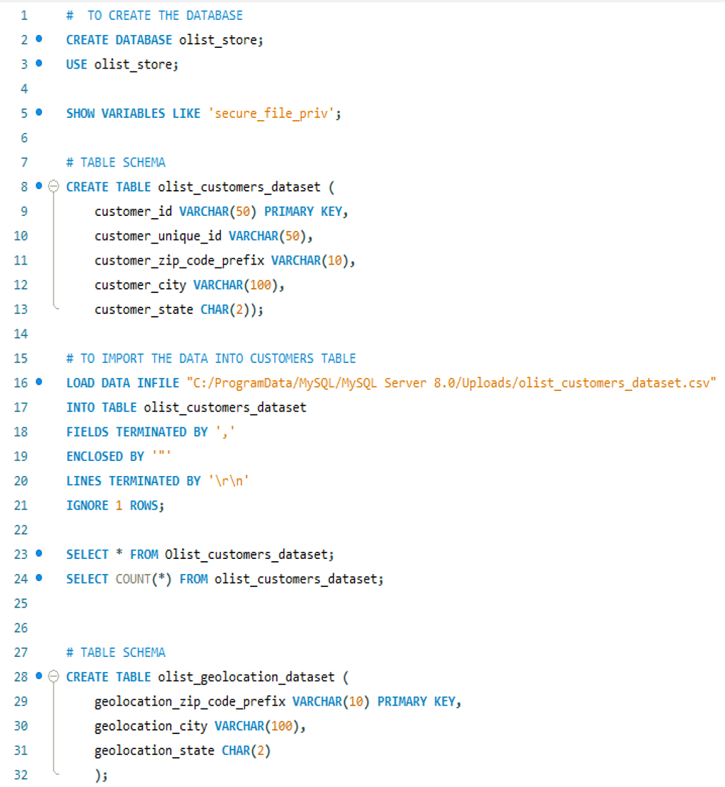
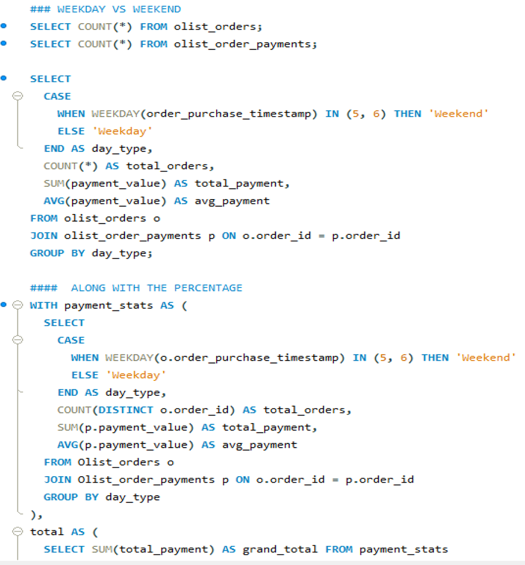
SQL Schemas

Slide 19
Thank You

